Slide 1




Requirements and Proposal Review
13 August 2024
This document summarises the Requirements for Infrastructure as Code setup and Naming conventions to be used when deploying the resources across different environments.
It also summarises the proposed high-level architecture of data warehouse project, Infrastructure and Source code version control.
James Hambro & Partners
DWH - Infrastructure Setup
© Xyenta

Slide 2
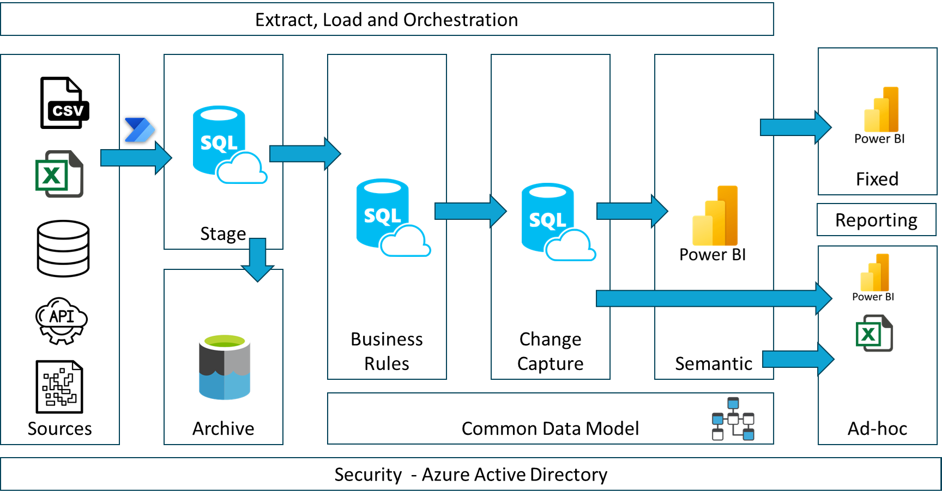
JHP – DWH Propose Architecture
© Xyenta

Slide 3
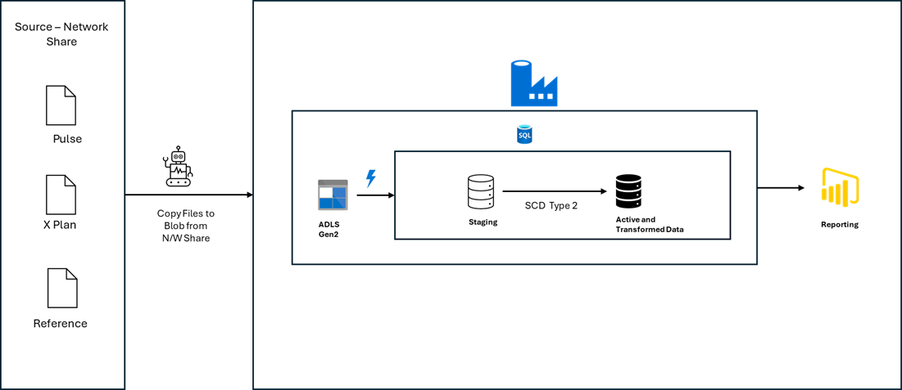
JHP DWH PoC – Flow of Data
This Slides gives an overview for flow of data from source to Database which can be utilised for visualizations and business insight's purpose.
© Xyenta

Slide 4
What is Infrastructure as Code?
Infrastructure as code (IaC) is used for infrastructure automation to create environments. The most common use of IaC is in software development to build, test, and deploy applications. Traditionally, system administrators used a combination of scripts and manual processes to set up infrastructure environments.
Refer to next slide for different types of IaC languages.
© Xyenta

Slide 5
Consideration for Infrastructure as a Code
Terraform is an infrastructure as code tool that lets you define both cloud and on-prem resources in human-readable configuration files that you can version, reuse, and share. You can then use a consistent workflow to provision and manage all your infrastructure throughout its lifecycle. Terraform can manage low-level components like compute, storage, and networking resources, as well as high-level components like DNS entries and SaaS features.
ARM template is a JavaScript Object Notation (JSON) file that defines the infrastructure and configuration for your project. The template uses declarative syntax, which lets you state what you intend to deploy without having to write the sequence of programming commands to create it. In the template, you specify the resources to deploy and the properties for those resources.
Bicep is a domain-specific language (DSL) that uses declarative syntax to deploy Azure resources. In a Bicep file, you define the infrastructure you want to deploy to Azure, and then use that file throughout the development lifecycle to repeatedly deploy your infrastructure.
© Xyenta

Slide 6
Comparison and Solution
 | ARM Templates | Microsoft BICEP | Terraform
State File | Not needed | Not needed | Need to be in Sync
Complexity | Bit complex | Easily understandable | Easy understandable
Support | Immediate support | Immediate support | Needs time
 | Doesn’t support Other cloud platforms | Doesn’t support Other cloud platforms | Supports multi-cloud platform
Pricing | Free | Free | 20$ per User/Monthly (Enterprise)
Solution Implementation : For JHP DWH Infrastructure Implementation, MS BICEP has been chosen as preferred solution as Microsoft provides regular updates and .
© Xyenta

Slide 7
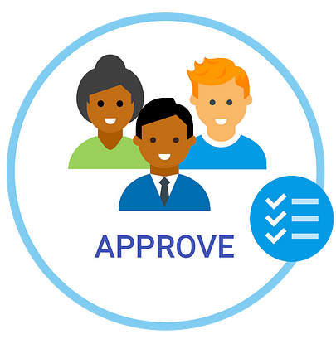



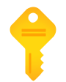
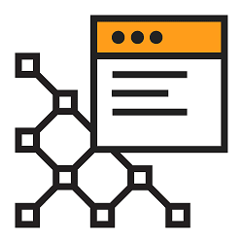
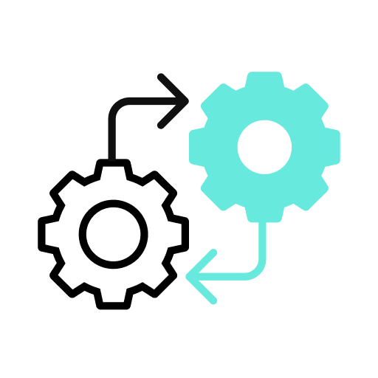

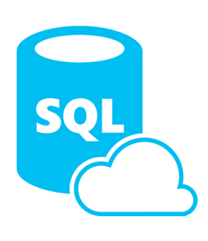
Infrastructure as a Code Design
BICEP Modules
1. Parameters
Main.bicep
Code for Main.bicep will be stored in parts as modules in Azure Git
For CI / CD process, Azure DevOps pipelines will be implemented for controlled deployments based on approvals for different environments
© Xyenta

Slide 8
Repository Required in Azure DevOps
Infrastructure Repo
Jhp-dwh-iac-repo
Azure Synapse Analytics
Jhp-dwh-asa-repo
Azure SQL Database
Jhp-dwh-sqldb-repo
© Xyenta

Slide 9
Resources Required for DWH Implementation
Azure Storage Gen 2
Azure Synapse Analytics
Azure Key Vault
Azure Logic Apps
Azure SQL Database - 10 to 30 DTUS based on Environment (if req)
© Xyenta

Slide 10
Resource Naming Convention
Resource Name | Resource Naming
Azure Storage Gen 2 | dwhadlsgen201<reg><ENV>
Azure Synapse Analytics | refer to synapse naming slide
Azure Key Vault | dwh-kv-01-<reg>-<ENV>
Azure SQL Database | Dwh-asql-01-<reg>-<ENV>
Azure Logic Apps | Dwh-ala-01-<reg>-<ENV>
Azure SQL Server | Dwh-sqlsrvr-01-<reg>-<ENV>
Note :
Environment (env) –
Dev
UAT
Prd
Region (reg)– UK South (UKS)
© Xyenta

Slide 11
Azure Synapse Analytics Naming Conventions
Name | Value
Managed Resource group | Dwh-asa-01-<reg>-<ENV>
Account Name | Refer to Azure Storage Gen 2 in prev. slide
File System Name | Dwh-fs-01-<reg>-<ENV>
Authentication Method | Use both local and Microsoft Entra ID
SQL Server Admin Login | Dwhasasqladmin<Env>
SQL Server Admin Password | as per client standards
System assigned managed identity permission | Allow network access
Apache Spark Pool | Dwh-asp-01-<reg>-<ENV>
© Xyenta

Slide 12
Security for Azure Pipelines and Resources
Security is a quite important of data governance and release management of product to higher environments in a controlled manner via automated deployment process. Following are secure measures will be implemented
Service Principal
Security Groups - Azure Active Directory / Entra ID
Managed Identities
Proxy / Service Accounts
© Xyenta

Slide 13
Security Naming Standards
Security Name | Security Value
Service Principal | cicd-dwh-<env>-sp
Developer | Sec. Azure.dwh.developers.<env>
user | Sec. Azure.dwh.users.<env>
Application Registration | App-dwh-<resourcename>
Application Secret | Appscrt-dwh-<resourceName>
Note :
Environment (env) –
NonProd
Prod
Region (reg)– UK South (UKS)
© Xyenta

Slide 14
Permissions for resources
Resource Name | Developers – NonProd | Developers –Prod | Users – NonProd | Users – Prod
Key Vault (Secret Management) | Key Vault Administrator | Key Vault Reader | NA | NA
Storage Account | Storage Blob Data Owner | Storage Blob Data Contributor | Storage Blob Data Contributor | Storage Blob Data Reader
Azure Synapse Analytics | Synapse Contributor | Xyenta Devs: Synapse Monitoring Operator, Synapse Artifact User, Synapse Compute Operator – To provide monitoring / debug support in prod Developers Prod: Artifact User | Synapse Artifact User | Synapse Artifact User
Azure SQL Database | Sys Admin | DB_datareader, Db_DataWriter (Opt) | DB_datareader | DB_datareader
Azure Logic Apps | Logic Apps Standard Contributor | Logic App Standard Reader | NA | NA
Azure Pipelines (CI / CD)
© Xyenta

Slide 15
Git Branching Strategy
The Git branching strategy mainly would have the following branches which are all protected
main → Will used for deploying to Prod or UAT
test → UAT and Development
development → Only Development
Publish (Only for Synapse) → Development branch gets merged for deployment of pipelines / Notebooks from development branch for publishing artifact in Dev workspace
Feature branches for Development of features which can be merged as follows
Features→ development → test → main
© Xyenta

